Slide 1


WELCOME
30th Annual
Convention & Trade Show

Slide 2

#NARPM2018

Slide 3
HOW TO ADD
A DOOR A DAY
(at $191 a Door)
Effective Door Growth Through
Multiple Marketing
& Distribution Channels
Scott P. Brady
Progressive Property Management, Inc.
Partners Real Estate Group

Slide 4


OUR ULTIMATE MISSION

Slide 5
OUR ULTIMATE MISSION
We target desirable customer SEGMENTS
  SMIPOs, Investors, Multi-Unit & (one day, perhaps) HOAs
Promoting Our Unique 4 PILLARS
  Total Transparency, Compelling Value Propositions,
  Stellar Customer Service & Aggressive Pricing
Using Multiple MARKETING Channels
  Direct mail, SEO, Google ads & Local Landlord Seminars
Through Multiple DISTRIBUTION Channels
  Retail, Virtual & Wholesale
To Create Profitable Revenue STREAMS
  Management, Real Estate, Maintenance, Insurance & Escrow

Slide 6

5 TRENDS CREATING MORE RENTALS

Slide 7
5 TRENDS CREATING MORE RENTALS
The California (Nation) Renter State
  Rent Control & Just Cause Eviction
  Repeal of Costa-Hawkins/The Affordable Housing Act of 2018
The Great Recession of 2019 (or 2020, 2021, or 2022)
  Temporary Landlords
  Misbehaving Tenants
Greater Complexity
  Legal
  Liability
  Fair Housing Laws
Inexorable Demographics and Economic Trends
  Millennials Delaying Home Purchase
  Baby Boomers Staying Put
  Not Enough Product for the People
Technology Acceleration in 10 to 20 Years
  Taking Driverless Electric Vehicles to Hot Yoga

Slide 8
CALIFORNIA 49TH IN OWNER OCCUPIED
Bottom 4 States
When It Is Cheaper to Rent Than it is to Buy, People Rent.

Slide 9
THE 3 NEW BASIC RIGHTS?
UNIVERSAL HOUSING
  Rent Control/Repeal Costa-Hawkins
  Expand Section 8
    “Every family below a certain income level would be eligible for a housing voucher.”
    Pulitzer Prize Winning “Evicted: Poverty and Profit in the American City”
UNIVERSAL HEALTHCARE
  Mandatory for Every Employer
    “We will have universal healthcare in the State of California.”
    Gavin Newson
UNIVERSAL BASIC INCOME
  50% of Jobs at Risk of Being Displaced in the Next 30 Years
    “There are fewer and fewer jobs a robot cannot do better.”
    Elon Musk

Slide 10

PIVOT & PROFIT FROM CHANGE
“PROFIT IS THE PAYMENT YOU GET WHEN
YOU TAKE ADVANTAGE OF CHANGE.”
Joseph Schumpeter, Economist, popularized the term “creative destruction”

Slide 11

WE THRIVE IN ANY REAL ESTATE MARKET

Slide 12
WHY WE’LL RULE THE REAL ESTATE WORLD
What we do will not go away any time soon.
More SMIPOs are using us because they see our value.
We can provide income and leads to real estate agents.
The demographic, legal and income trends favor us.
We look forward to real estate recessions
(it’s our time to shine).
We will shape the real estate future
(one door at a time).

Slide 13


REAL ESTATE SALES VS. PROPERTY MANAGEMENT
HOW THE WORLD SEES REAL ESTATE….
…AND THEN PROPERTY MANAGEMENT
Big Commissions: All the Glory
The 3 T’s: Toilets, Tenants & Troubles
WE ARE IN THE NICKEL BUSINESS, NOT THE DOLLAR ONE.

Slide 14

THE BEAUTIFUL BLUE SMIPO OCEAN OF 2014

Slide 15

THE SMIPO SILENT MAJORITY
Self-Managing Investment Property Owners

Slide 16
WHY TARGET THE SMIPOS?
COLOSSAL MARKET
  22 million Nationwide
  5 million Rentals in California
  1+ million in Los Angeles, Riverside, San Diego, San Bernardino & Orange County
GETTING COLOSSAL-ER
  More Investors Parking Money in Rentals
  More Owners Converting Properties to Rentals
  More Tenants Happy with the Rental Lifestyle
GETTING MORE COMPLICATED
  Fair Housing Laws
  Rent Control & Just Cause Eviction
  Savvy Tenants Know How to Game the System
  The California Renter State

Slide 17
HOW COLOSSAL IN ORANGE COUNTY, CALIFORNIA?
The Baseline in Orange County
  3,114,000 Total population
  1,058,470 Total households
  444,557 Total rental stock (42%)
  311,190 Total private investment properties (70%)
If 75% of SMIPOs Become 60%
  77,797 Current Non-SMIPOs
  124,476 Future Non-SMIPOs (at 60%)
  46,679 New Doors to be managed at 60%
If 58% of Owner Occupied Becomes 40%
  635,082 Total rental stock
  444,557 Total private investment properties
  133,367 New doors at 40%
If There is a Recession by 2020
  30,000 Annual sales in recovery market
  22,000 Annual sales in a recessionary market
  12,000 new doors in a normal recession
86,020 New Managed Doors in a ’Good Squall’
156,480 New Managed Doors in a ‘Perfect Storm’
Only 93,357 Doors Currently Under Management

Slide 18
LET’S ASK SOME SMIPOS
WHY DO THEY SMIPO?
WHY DO THEY STOP SMIPO-ING?

Slide 19
LET’S ASK SOME SMIPOS
WHAT IT TAKES TO STOP SMIPO-ING
HOW DO THEY FEEL NOT SMIPO-ING?

Slide 20

THE 4 PILLARS OF PROGRESSIVE
THE 4 PILLARS
VALUE
TRANSPARENCY
SERVICE
PRICE

Slide 21
THE TRAITS REQUIRED TO ATTRACT SMIPOS
  THEY MUST TRUST YOU.
    You must offer COMPELLING VALUE PROPOSITIONS to the SMIPOs.
      They must see the value in what you offer and trust that you will be able to do a better job than them.
  THEY HAVE TO BELIEVE YOU.
    You must make your business COMPLETELY TRANSPARENT to them.
      They must know that you will do as you say you will do.
  THEY WANT TO LIKE YOU.
    You need to provide STELLAR CUSTOMER SERVICE at every level.
      The only way to gauge their future experience is to evaluate your current relations with owners and tenants.
  THEY DEMAND A “FAIR” PRICE.
    You should price for what the market will bear at the LOWEST COST possible.
      They are paying nothing now so they are price sensitive.

Slide 22

COMPELLING VALUE PROPOSITIONS

Slide 23

COMPELLING VALUE PROPOSITIONS
The 8 Guarantees: Payment, Service, Fee, Response,
Satisfaction, Tenant, Happiness & Rental Guarantees.

Slide 24

TOTAL COMPANY TRANSPARENCY
Totally Transparent With The World.

Slide 25
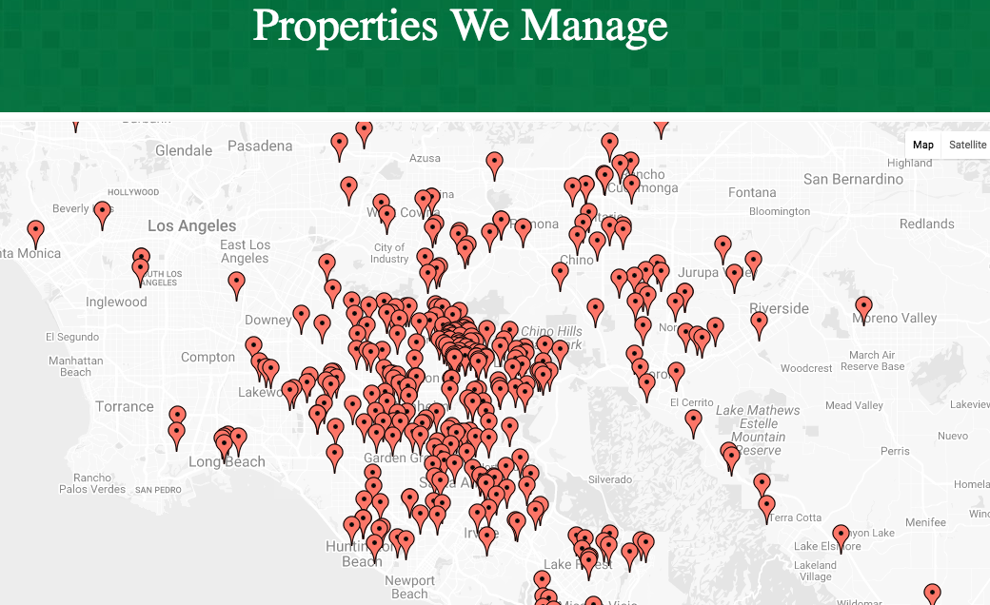
WHERE WE MANAGE MAP

Slide 26
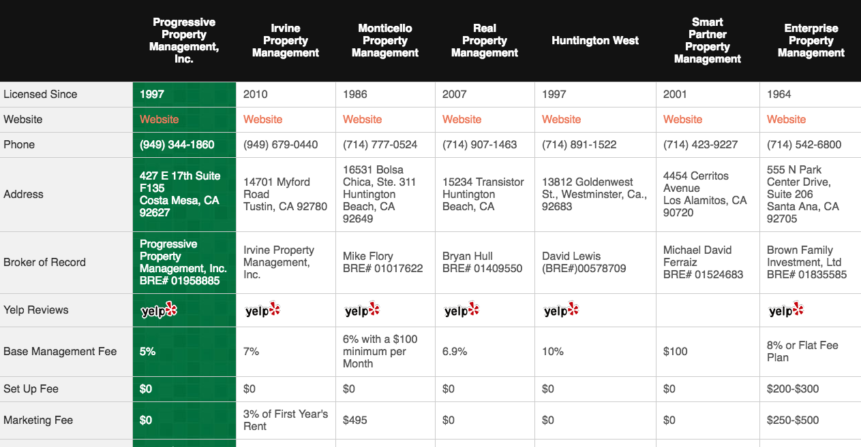
THE COMPARISON CHART

Slide 27
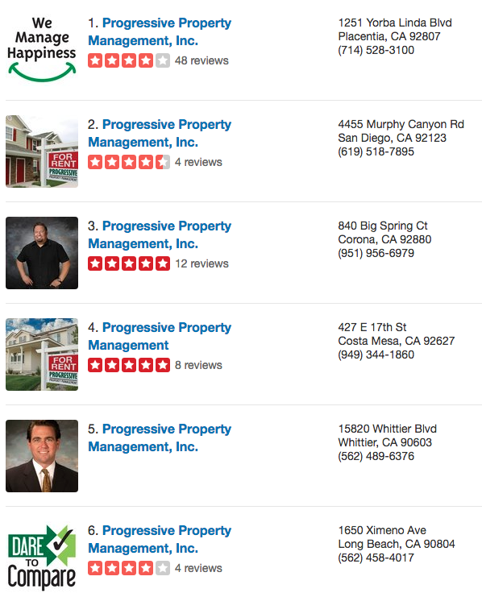
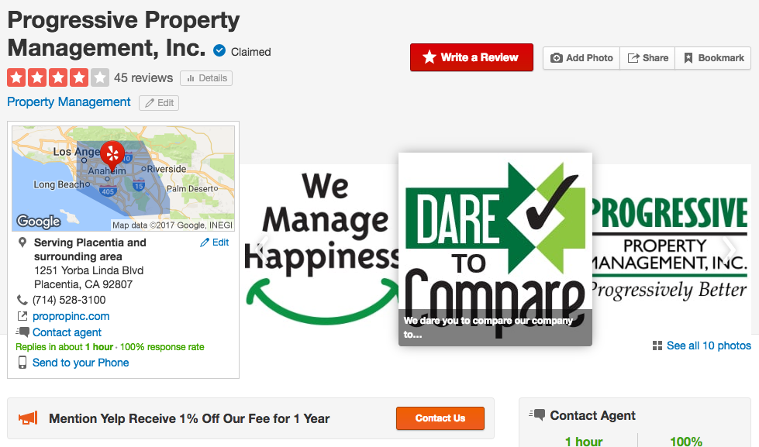
REPUTATION MATTERS

Slide 28
THE DISTRIBUTION CHANNELS
RETAIL
  Traditional Property Management
  All Income Retained by Company
VIRTUAL
  Branch Managers
  Licensees of the Company
  65/35 Split on Property Management Income
  90/10 on Real Estate Related Income
WHOLESALE
  JV’s with Brokers and Real Estate Companies
  65/35 Split in Management & Leasing Income
  No Income on Real Estate Sales

Slide 29
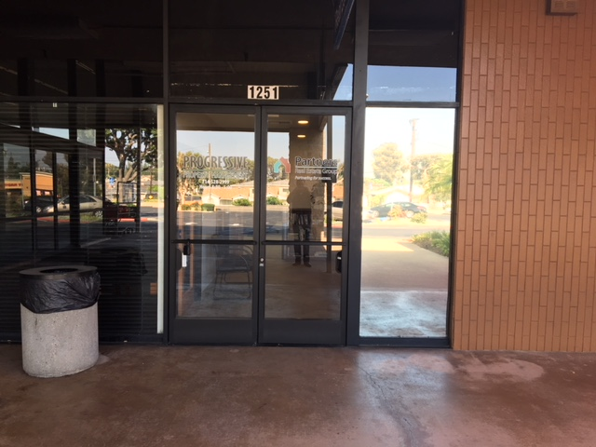
OUR BRICKS & MORTAR

Slide 30

“VIRTUAL” BRANCHES

Slide 31
WHY “VIRTUAL” BRANCHES?
WIIFT? WHAT’S IN IT FOR THEM?
WIIFY? WHAT’S IN IT FOR YOU?
Exit the Income Roller Coaster
Every Door Counts
Work the Network
Small Business Owner
It’s in Their Wheelhouse
Doors Give Purpose
They Sell as Well
Quick Expansion
Better Market Penetration
They Pay for Doors
Ancillary Income
Invisible Handcuffs

Slide 32

GOOD “VIRTUAL” AGENTS ARE HARD TO FIND
ACTIVE
  Sell 2 to 5 Homes a Year
SMART
  Can Learn the Business
HUNGRY
  Need the Income
LONG TERM CAREER
  Looking to Stay in the Industry
  5 to 10 Years
EMPHATHETIC
  Care About Caring
THEY’VE “DONE” IT
  They Manage Now/Before
THEY ”GET” IT
  Get Rich Slow

Slide 33
GOOD “VIRTUAL” AGENTS ARE HARD TO FIND
SEMINARS
  Exit the Real Estate Income Roller Coaster
  How to Build a Profitable Property Management Business
  Thrive in Any Real Estate Market
DIRECT MAIL/EMAIL
  One Stop Shop Direct Mail
  Email Marketing
  Use “Reduced Cost Brokerage” as Your Farm
TEST WITH A DOOR OR TWO
  How Quick to Grasp the Concepts/2 Day Shadow
  Branch Manager Quiz
  Survey First Owner & Tenant

Slide 34

BECOME A “ONE STOP SHOP” COMPANY

Slide 35

BUY A DOOR PROGRAM

Slide 36
THE DOOR SOURCES
BUY
  3 Times the Monthly Management Income
  Plus an On Boarding Fee
  Moving to a “Bid a Door” System
BUILD
  Centralized Marketing
  Pay for Local Advertising
  Costs Deducted out of Management Income
FIND
  Networking
  Sphere
  17 Independent Business Development Managers

Slide 37
PROGRESSIVE AGENT ASSISTANCE
Broker/Agent/Brokerage Operates Branch Independently
  “Buys” a Door
  “Builds” a Door
  “Finds” a Door
  Manages Tenant and Owner Issues
  Schedules Vendors
  Conducts Inspection
  Goes to Court/Small Claims
  Leases Up Properties
  Sells Properties
  “Owns” the Door
  First Right of Refusal at Exit
  Pay 6 Months Management Income
  What I Care About:
    Compliance
    Customer Service
    Profitability
Joint Venture with Progressive Property Management, Inc.
  65% Retained by Branch Manager
  35% of Gross Retained by PPM
    Training
    Sales Support
    File Audit
    Insurance
    Rent Collection
    Owner Disbursements
    Vendor Payments
    Operations
    Global Marketing
    JV Marketing
    Management
    BRE Compliance
    Trust Accounting
    Reconciliations
    Management Software
    Reporting

Slide 38
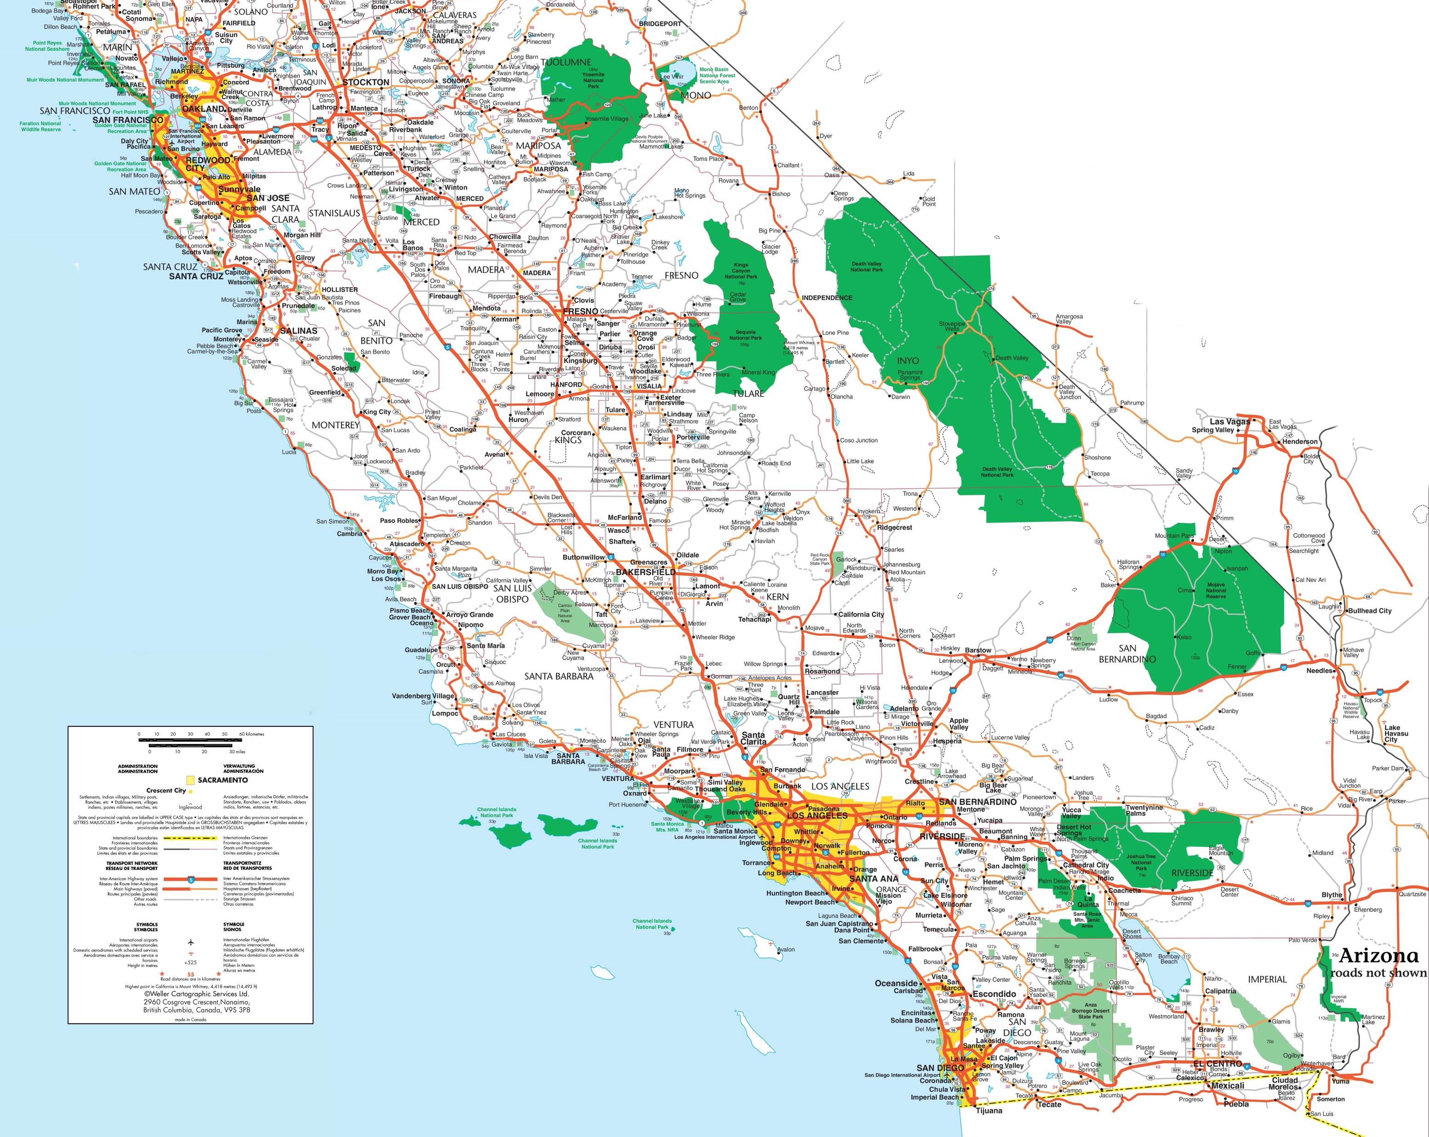
VIRTUALLY COVERING ALL OF SOCAL

Slide 39

WHOLESALE YOUR COMPETENCIES

Slide 40
PROPERTY MANAGEMENT IS A COMPLICATED BUSINESS
YOU NEED TO BE GREAT AT A NUMBER OF FUNCTIONS
  Marketing
  Sales
  Operations
  Lead Conversion
  Inspections
  Owner/Tenant Issues
  Leasing
  Accounting
  Compliance
  Bookkeeping
  Reporting
  Vendor Coordination
  Reputation Management
  Human Resources
MOST SMALL (50 TO 100 DOORS) SHOPS ARE GOOD AT JUST A FEW THINGS
  Leasing
  Management Software
  Vendor Coordination
  Owner Issues
  Tenant Issues
MANY RUNNING RISKY OPERATIONS
  Insurance
  Trust Accounting
  Labor Relations
  Reconciliations
  Franchise Tax Board
  Compliance
PROGRESSIVE EXCELS AT OUTSOURCING SALES, MARKETING & OPERATIONS

Slide 41



THE OUTSOURCING RESOURCE TO OTHER PROPERTY MANAGEMENT COMPANIES
OPERATIONS
  Rent Collection
  Owner Disbursements
  Compliance & Reporting
  Sales & Marketing
  Reputation Management
  Bookkeeping & Reconciliations
MAINTENANCE
  Handyman Services
  Lease Ups
  Clean & Shows
  Landscaping
ONSITE INSPECTIONS
  Move-Ins/Move-Outs
  Periodic
  Drive-Bys

Slide 42
WHOLESALE GROWTH STRATEGY
AGENTS
  Illegally Managing Doors
  Broker Unaware of Activity
  Broker Unaware of Risk
SMALL PROPERTY MANAGEMENT COMPANIES
  Stuck at No Man’s Land
  Uninsured - Noncompliant
  Can Focus on Profitable Activities
REAL ESTATE BROKERAGES
  Want In On the Property Management Action
  Require Agents to Refer – Agent Gets Sale
  For 50%, We Assign a Broker

Slide 43
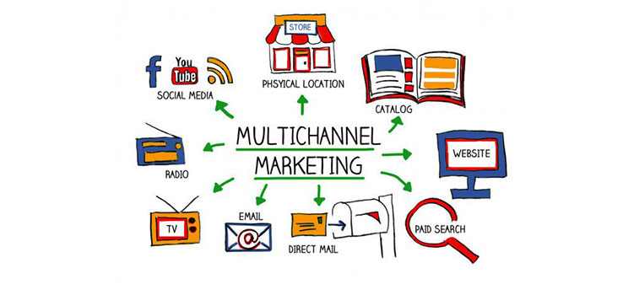
MULTIPLE MARKETING CHANNELS

Slide 44
DOOR SOURCES
THE HIGHER YOUR PERCEIVED VALUE, THE HIGHER YOUR CONVERSION RATE
HIGHER VALUE DOORS
  Direct Mail
  Client Referral
  Local Landlord Seminars
  Yelp
  Google SEO
  Realtor Referral
LOWER VALUE DOORS
  Geek Marketing
  Google Ads
  Thumbtack
  All Property Management
  CraigsList
  Facebook
Property Management is Presently 80% about Price
Our Goal is to Make it about Value 50% of the Time

Slide 45
DOOR SOURCES
YEAR | DIRECT MAIL | GOOGLE | YELP | SEMINARS | FOUND/ BUILD | TOTAL NEW DOORS
2013 | 10 | 10 | 10 | 0 | 0 | 30
2014 | 40 | 10 | 20 | 0 | 10 | 80
2015 | 80 | 25 | 35 | 0 | 13 | 153
2016 | 100 | 35 | 30 | 0 | 18 | 183
2017 | 110 | 45 | 25 | 25 | 21 | 226
2018 | 145 | 150 | 30 | 45 | 55 | 425
2019 | 185 | 195 | 40 | 65 | 85 | 600

Slide 46
DOOR COSTS
YEAR | DIRECT MAIL | GOOGLE SEO | GOOGLE ADS | YELP | SEMINARS | TOTAL COST
2013 | $30,000 | $6,000 | $0 | $18,000 | $0 | $54,000
2014 | $36,000 | $6,000 | $0 | $18,000 | $0 | $60,000
2015 | $42,000 | $6,000 | $0 | $18,000 | $2,000 | $68,000
2016 | $48,000 | $6,000 | $0 | $12,000 | $4,000 | $70,000
2017 | $60,000 | $6,000 | $24,000 | $12,500 | $8,000 | $110,500
2018 | $72,000 | $30,000 | $48,000 | $6,000 | $12,000 | $168,000
2019 | $84,000 | $40,000 | $60,000 | $6,000 | $18,000 | $208,000

Slide 47
A DOOR A DAY AT $191
YEAR | NEW DOORS | GROSS MARKETING | BIZ DELV | TOTAL MARKETING | DOOR SALES | COST PER DOOR
2013 | 30 | $54,000 | $0 | $54,000 | $0 | ($1,800)
2014 | 80 | $60,000 | $0 | $60,000 | $0 | ($750)
2015 | 152 | $68,000 | $0 | $68,000 | $0 | ($447)
2016 | 183 | $70,000 | $0 | $70,000 | $57,750 | ($66)
2017 | 226 | $110,500 | $0 | $110,500 | $75,250 | ($155)
2018 | 425 | $168,000 | $20,000 | $188,000 | $106,750 | ($191)
2019 | 600 | $208,000 | $60,000 | $268,000 | $141,750 | ($210)

Slide 48
DOOR GROWTH CHANNELS
YEAR | RETAIL | VIRTUAL | WHOLESALE | TOTAL
2014 | 80 | 0 | 0 | 127
2015 | 90 | 43 | 0 | 260
2016 | 95 | 112 | 0 | 424
2017 | 95 | 89 | 0 | 608
2018 | 100 | 150 | 100 | 900
2019 | 100 | 200 | 200 | 1,400
2020 | 100 | 250 | 500 | 2,350

Slide 49
SMIPO + PILLARS + VIRTUAL PROPERTY MANAGEMENT + MARKETING = GROWTH
The SMIPO & Virtual PM Epiphany
Estimated Growth in our Market Areas

Slide 50



THE OUTSOURCING RESOURCE FOR SMIPOS
OPERATIONS
  Tenant Acquisition
  Contract Enforcement
  Property Marketing
  Monthly Payment Management
  Free Property Management
MAINTENANCE
  Handyman Services
  Lease Ups
  Clean & Shows
  Landscaping
ONSITE INSPECTIONS
  Move-Ins/Move-Outs
  Periodic
  Drive-Bys
THE RENTER STATE
  Landing Page
  RenterState.com

Slide 51

FISH WHERE THE FISH ARE
TARGET 100% OF OWNERS, NOT 5%

Slide 52
FISH WHERE THE FISH ARE
THE MYTHICAL CITY OF BRADYVILLE “A Nice Bunch of People”
300,000 Population - 100,000 Households - 35,000 Rentals
HOW MANY OWNERS CURRENTLY WITH PROPERTY MANAGEMENT COMPANIES ARE UNHAPPY?
  30% of Property Owners Use Property Management
  Less than 5% are not Satisfied with their Company
  525 a Year or 43 per Month
HOW MANY INVESTMENT PROPERTY OWNERS ARE CURRENTLY LOOKING FOR MANAGEMENT SERVICES?
  70% of Owners Self-Manage - 5% Each Year Hit a Pain Point
  1,225 a Year or 102 per Month
HOW MANY SELF-MANAGING INVESTMENT PROPERTY OWNERS COULD USE MORE HELP BEING BETTER PROPERTY MANAGERS?
  24,500 - 40% Out of Area/Out of State Looking for Assistance
  9,800 a Year or 816 per Month
100% OF OWNERS (35,000) NEED MORE INFORMATION

Slide 53

THE LOCAL LANDLORD SEMINAR

Slide 54

THE LOCAL LANDLORD SEMINAR
HELP OWNERS BECOME BETTER LORDS OF THE LAND

Slide 55
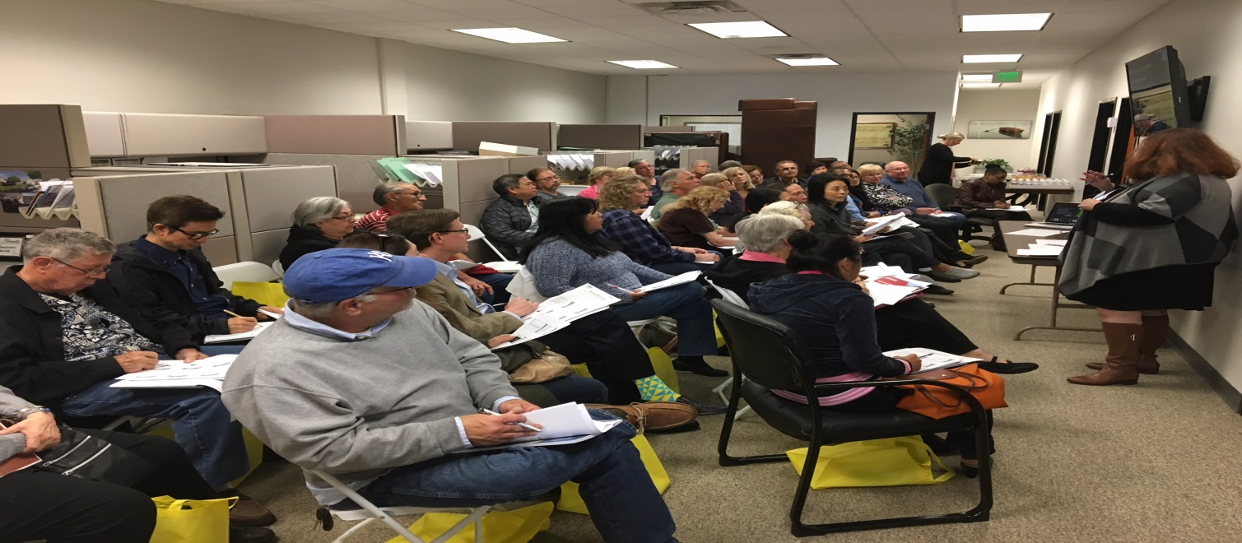
THE LOCAL LANDLORD SEMINAR
4th Seminar at Our Main Office 3/10/2018
  2,000 Postcards Sent to Local Investment Property Owner
  45 Attendees on the Day of Event
  10 Interested in our Management Services
  2 Interested in Buying/Selling Investment Properties
  0 Sandwiches Remaining

Slide 56

THE REVENUE STREAMS

Slide 57
SOURCE OF THE REVENUE STREAMS
PROPERTY MANAGEMENT
  Progressive Property Management, Inc.
TRADITIONAL REAL ESTATE
  Partners Real Estate Group
    90/10 Split
REDUCED COST REAL ESTATE
  3Point5 Realty
    3.5% Total Cost to Sell
REDUCED COST BROKERAGE
  Progressive Realty Group
    $250 Monthly Fee
INVESTMENT SYNDICATIONS
  Carpe Diem Developers
    10% Investment Fee
MAINTENANCE DIVISION
  Sierra Maintenance Services
  Onsight Inspections
MAPFRE INSURANCE
  Sierra Vista Insurance Services
ESCROW
  Ally Escrow
BRADY CONSULTING GROUP
THE BRADY BUNCH OF REALTORS

Slide 58
THE MONTHLY VALUE OF A DOOR ($177)
Management Income from Owners
  Monthly Management Fee
  Tenant Acquisition/Placement
  Eviction Assistance
  Late Fees
  Applications Fees
Affiliated Income Streams
  Analyzed Bank Accounts
  Onsight Inspections
  Maintenance Revenues
  Carpet Cleaning
  Applications/Lease Ups
  Insurance – Renter’s, Owner’s & Auto
Management Income from Tenants
  Annual Lease Renewal
  Lease Breakage
  Lease Administration Fee
  Tenant Liability Insurance
  Pet Screening Services
  Owner Eviction Protection
Other Income Streams
  Personal Residential Sales
  Branch Manager Residential Sales
  Reduced Cost Monthly Agent Fee
  Landscape Services
  Escrow Income

Slide 59





THE PROFIT PICTURE
NEW DOORS SOLVE (NEARLY) ALL YOUR PROBLEMS
Rental Inspections
Medium Value
Low Margin
Residential Escrow
High Value
High Margin
High/Med/Low Value
Low Margin
Investment Property Sales
High Value
High Margin
Property Maintenance Services
High Value
Low Margin
Reduced Cost Brokerage
Low Value
Medium Margin
Full Service Real Estate
Medium Value
Medium Margin
Renter’s, Owner’s & Auto Insurance
Low Value
Low Margin
Residential Property Sales
High Value
High Margin
VALUE CHANNELS – PROFIT MARGINS

Slide 60
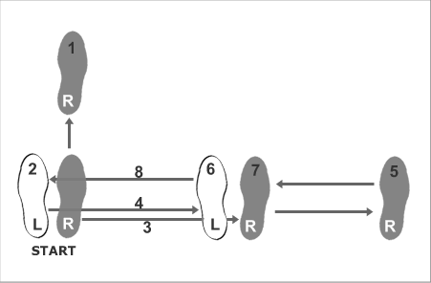
THE 3 BASIC STEPS FOR GROWTH

Slide 61
HOW TO REACH OUR GOALS (2018-2028)
EMBRACE MUTUAL ATTRACTION MARKETING
  Find the Customers You Like & Use Video to Let Them Like You Back
  They Know What You Do, Show Them You Like What You Do
  The Most Powerful Value Proposition is Mutual Affection
CREATE A FRICTIONLESS EXPERIENCE FOR ALL
  Make it Incredibly Easy to Do Business With You
  Promote Your Pillars (Competitive Advantages)
  Convert Your Website to a One Click Experience
BUILD AN UNASSAILABLE BRAND
  Become the Trust Leader in Your Marketplace
  You Have to be Great at What You Do
  Create a Mutually Dependent Company

Slide 62

CREATING ”LIKE” WITH STRANGERS
https://youtu.be/46s8P_BWNcU

Slide 63

& MAKE A DIFFERENCE…
MAKE A SMALL DENT IN THE REAL ESTATE UNIVERSE…
…ONE DOOR AT A TIME

Slide 64
Companies: Scott P. Brady is Broker/Owner of the following companies:
  Progressive Property Management, Inc.
  Partners Real Estate Group/Progressive Realty Group/3point5 Realty
  Sierra Maintenance Services
  Onsight Inspections
  Ally Escrow
  Carpe Diem Developers
  Brady Consulting Group
His Vision: Scott believes the future of real estate is the fusion of property management and real estate services and has built an organization reflecting this vision. Property management companies are in the unique position to leverage their competitive advantages in the real estate space and create a compelling business model for real estate agents.
His Background: Scott obtained his BA from UC Berkeley in Comparative Literature (German, Latin & English), his MBA from Cal State Fullerton and his broker’s license in 1995. In the last 22 years, has dabbled in every facet of real estate, and since 2012 has run a property management company now covering much of Southern California.
His Contact Information:
  Scott P. Brady
  scottbrady1963@gmail.com
  1251 Yorba Linda Blvd.
  Placentia, CA 92870
  (714) 528-3100
  www.ProPropInc.com (property management company)

